Slide 1
Roma Women Empowerment: A Change Under Construction
Towards a Roadmap for Advancing the Situation of Roma Women in the Council of Europe Member States
Research conducted by Dr Zora Popova for the CoE Roma and Traveller Team

Slide 2
Purpose
In support of the organisation of the 8th International Roma Women’s Conference (IRWC) in 2021 (ADI-ROM Terms of Reference)
To contribute to the CoE work dedicated to Roma women empowerment
To contribute to EC Roma integration efforts
To address issues and goals set by:
CoE Europe Gender Equality Strategy (2018-2023)
CoE Strategic Action Plan for Roma and Traveller Inclusion (2020‑2025)
UN Strategic Development Agenda 2030
To support CoE member states in their efforts to advance situation of Roma and Traveller women
Framework for assessment of gender aspect of Roma integration policies at national level
Model for national Roma Women Empowerment Roadmaps

Slide 3
Methodology
Research question: Are Roma integration policies ensuring efficient protection of Roma women’s rights (with focus on multiple and intersectional discrimination) and are they enabling development of the full potential of stakeholders?
Term used: Roma Women – CoE definition of Roma and Traveller developed further to indicate the lack of (reported) differences between the situation of Roma & Traveller women
Analytical framework: 2012 - European Women’s Lobby (EWL) Position Paper on Tackling Multiple Discrimination of Romani and Traveller Women
2013/2016 – European Parliament Resolution on Gender Aspects of NRIS
Comparative analysis: NRISs of BG, CZ, HU, RO, SK (Roma) & IE (Traveller)
NRIS = national strategic documents under international monitoring
Sources: NRIS 2020 – latest versions (as available)
Relevant strategic policy documents (for 6 states)
CoE/ADI-ROM thematic survey: replies received from AT, BA, BG, CH, CZ, DE, EE, EL, HR, HU, NO, RO, SK (Thank You!)

Slide 4
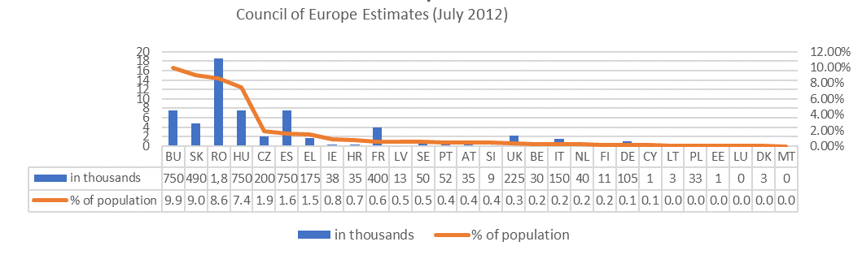
Selection of Cases
Roma in Europe as % of population
Gender Equality Index 2019

Slide 5
Analytical Framework
Normative basis | Policy Design | Policy Elements
General anti-discrimination law covering Roma women Normative/strategic documents on Roma women | Policy planning on ethnic/gender disaggregated data Gender impact evaluation Gender equality as a horizontal line in Roma inclusion Multiple discrimination / intersectionality Comprehensive measures Indicators Generation-sensitive approach Gender mainstreaming | Safety (protection from all types of violence) Cultural barriers (set by traditional practices and roles) Awareness raising of Roma women Training/awareness raising of public officials Education Employment Healthcare Housing Targeted social measures Participation (public/political life and decision making) Capacity building and support to NGOs

Slide 6
Findings
Normative basis | Policy Design | Policy Elements
Roma women and girls are protected by anti-discrimination laws In only few countries, multiple discrimination is also protected by law but there is no policy instrument addressing intersectionality Intersectional disadvantages constitute Roma women and girls as one of the most vulnerable groups in Europe They call for special attention and structured targeted intervention, supported by relevant legislative provisions and/or strategic policy plans | National governments have a clear understanding about the problems that Roma women face and about the multiple and intersectional discrimination that they are exposed to National Strategies for Roma Integration do not provide a comprehensive framework for tackling identified inequalities The embedded gender-sensitive measures are fragmented and rarely interconnected. Single-issue sectoral approach Generational differences are not considered Mainstreaming efforts are targeting eighter Roma or Women’s rights. Mainstreaming of Roma women issues at the levels of general societies and communities is not in focus. | In all the policy areas, but housing, measures explicitly targeting Roma women exist. No state has developed a comprehensive approach to ensure that all identified problems within a specific field are covered. No strategy offers a justification why only a few of the identified problems at national level are tackled. Integration policies do not offer mechanisms for reducing the negative impact of cultural barriers on Roma women empowerment. Raising awareness about Roma women issues and training of public officials, especially social workers, is crucial for increasing success of interventions. Mediators play an important role in the process of raising awareness of stakeholders and providing direct support to Roma women. Fostering civic initiatives and cooperation is crucial for achieving sustainable societal changes.

Slide 7
General Conclusions
Content analysis of policy documents should be performed alongside discourse analysis (women vs gender)
Positive actions targeting women (in policy documents) are rather an exception
Roma women, as stakeholders, are mostly silent on the topics of gender equality, intersectionality and multiple discrimination faced by them. The voice of Roma girls is still to be heard.
Comparative research on similarities and differences between the challenges faced by Roma women and those faced by Traveller women is generally missing. The speculation that they are identical is based on interpretation of reported problems but not on in-depth comparative analysis of underlying factors and their impact.
Increasing the level of protection and promotion of gender equality is a precondition for advancing the situation of Roma and Traveller women and eliminating the multiple disadvantages faced by them

Slide 8
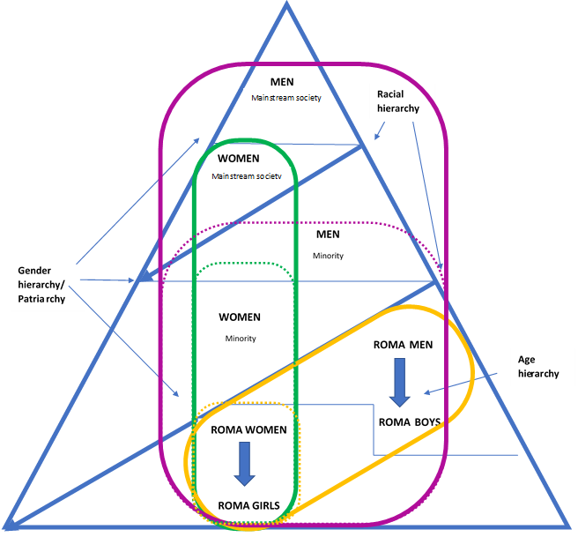
Pyramid of Discrimination & Lines of Solidarity

Slide 9
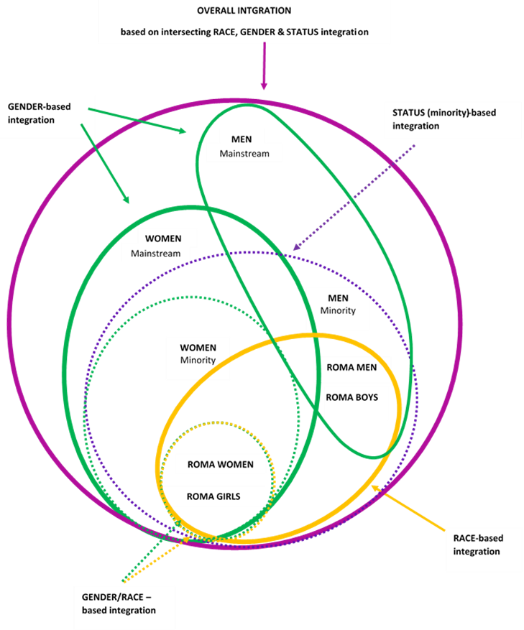

Slide 10
Persistent Challenges 2020
As reported by AT, BA, BG, CH, CZ, DE, EE, EL, HR, HU, NO, RO, SK (CoE/ADI-ROM thematic survey replies)
prejudices and discrimination - all states
multiple and intersectional discrimination – AT, BG, SK
cultural barriers and traditional practices – AT, BA, BG, CH, EE, EL, HU, including fear from loss of identity – NO
violence and injustice - DE, CZ
low level of participation and lack of leadership - CH, CZ, HR, SK
lack of institutional support – NO
lack of awareness and capacities of public officials regarding Roma women issues - BG
quality of housing conditions - SK

Slide 11
Policy Recommendations
Protection of women’s safety
Public authorities must protect cultural rights of communities, but cultural expression cannot excuse violation of human rights
Governments cannot outsource their obligation to protect human rights and prevent their violations.
States need to develop capacities and integrated approaches for addressing efficiently the multiple and intersectional challenges faced by Roma women
Specific strategies aiming at Roma women empowerment
comprehensive sets of mechanisms
all sectors of identified needs for intervention
involving all relevant stakeholders (both authorities and civil society)
Discrepancies between rural and urban environments or regional development specifics might entail adjustments of measures so that they meet context-specific challenges
Multi-level and multi-faceted mainstreaming programmes at three levels: general society, Roma communities & Roma women
All measures must lead to eliminating discrimination (multiple and intersectional)
Raising awareness among Roma women about human and gender rights is a precondition for their emancipation and active participation in public and political life
Governments need to map stakeholders and to establish mechanisms for structured dialogue and partnership
Provision of capacity building assistance and fostering intercultural cooperation are preconditions for achieving sustainable positive changes

Slide 12
Roma Women Empowerment Model
Step 1 | Step 2 | Step 3
ENSURING PROTECTION | ENABLING EMANCIPATION | FOSTERING COOPERATION
Normative Institutional Personal (including from health-related risks, from violence, from discrimination) | Education Employment Participation Awareness raising Building a vision for the future | Institutional and grassroot Involvement in decision-making Capacity building of civil society organisations Financial support to programmes to inter-cultural programmes & activities

Slide 13
The Way Forward
Without a minimum level of guaranteed personal security, emancipation is not be feasible and no real cooperation based on mutual respect can occur.
To advance the situation of Roma women in Europe, coherent and comprehensive approaches to Roma women empowerment need to be developed at national level.
The positive change that international and national actors have been trying to achieve for decades calls for structured policies and constructive measures synchronized within and across borders.

Slide 14
Thank you for your attention!
Dr Zora Popova
Researcher / Analyst
popova@instarc.eu

